Slide 1
FACE RECOGNITION - KNN
A face recognition app based on a KNN trained model.

Slide 2
What is a face recognition app?
A face recognition app is a software application that is able to identify a person from a digital image or video frame.
This is typically done by comparing the features of the face in the image or video frame to a database of known faces and finding a match.
It is widely used in several sectors (Security and law, Social media, Marketing).

Slide 3
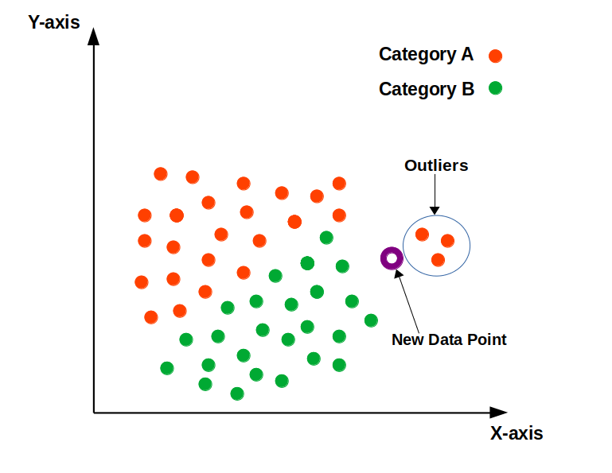
What is KNN algorithm?
K-nearest neighbors (KNN) is a simple, yet powerful machine learning algorithm used for classification and regression tasks. In a classification task, the goal is to predict the class of a given data point based on the classes of the other data points around it. In a regression task, the goal is to predict a continuous value for a given data point based on the values of the other data points around it.

Slide 4

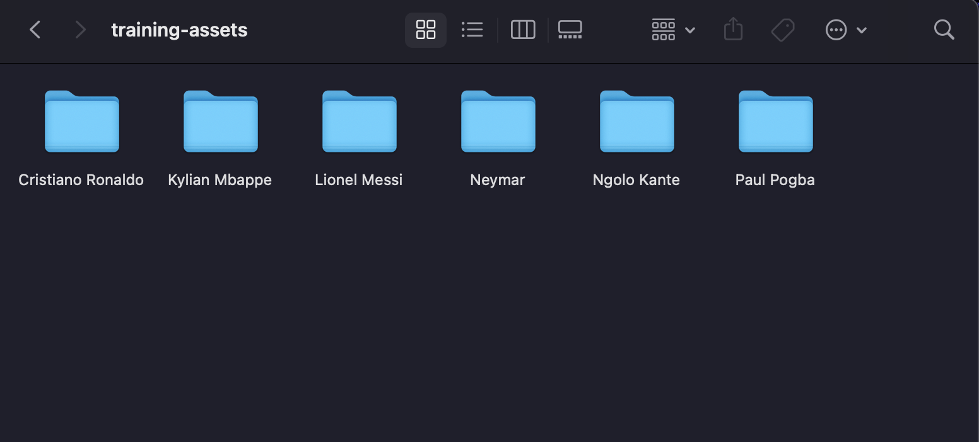
What is the dataset structure ?

Slide 5
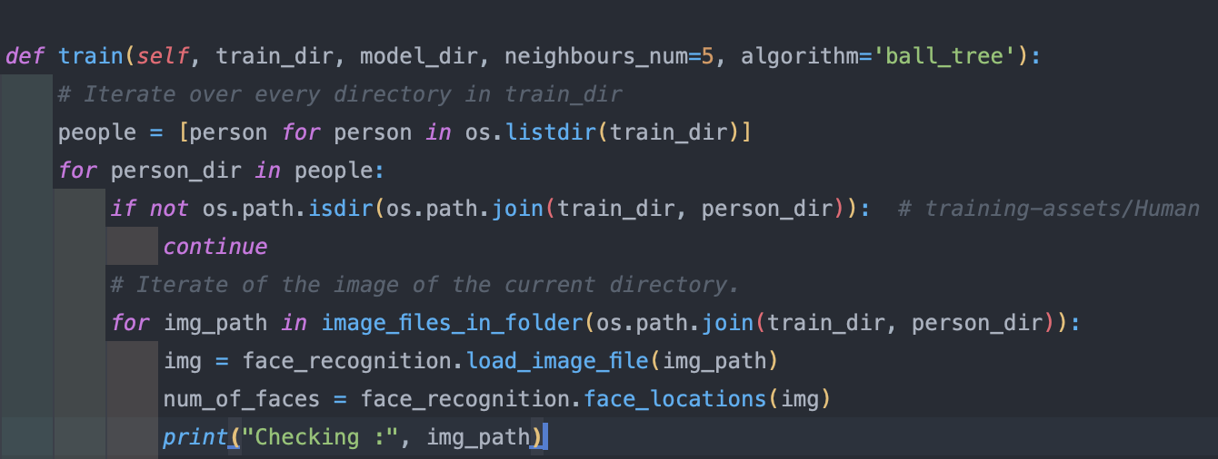
How the model is trained ?
In train function we iterate over the train_dir which contains the folders of the players.
Then we iterate over every picture in players folders.
The function then uses face_recognition library to recognize the face in the picture.

Slide 6
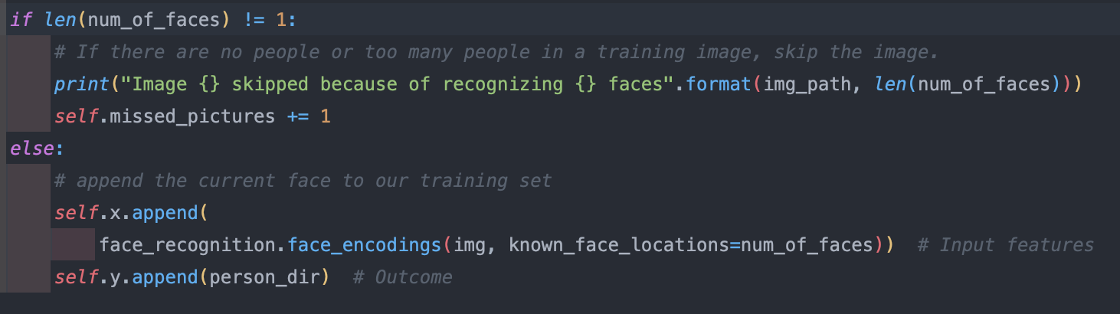
How the model is trained ?
Here we handle the appending of our face encodings to our x, y data.
If the number of the faces in a single picture is more than or less than (1) we cancel the adding to our x, y data.
Otherwise we append the face encodings to x, y lists.

Slide 7
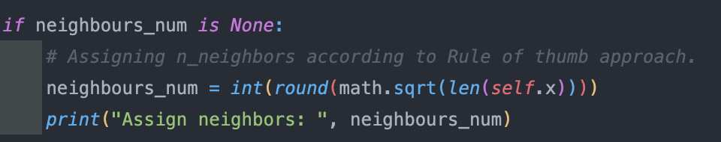
How the model is trained ?
Here we assign a value for the neighbours_num if the function was not called without assigning a value for it.
We assign the value of neighbors using the Rule of thumb.
Rule of thumb approach is assuming K neighbors value to be the Square root of samples in the dataset.

Slide 8
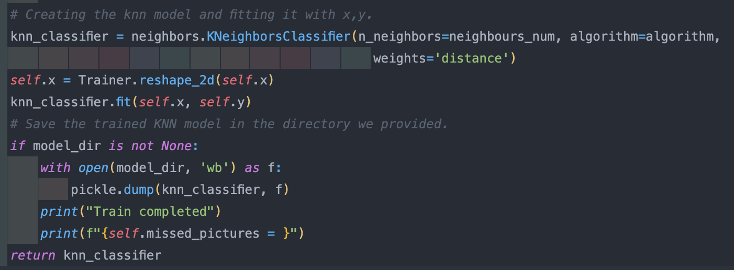
How the model is trained ?
Here we create the KNN model by passing K neighbors value to the KNeighborsClassifier class in Sklearn library.
We then call fit function and pass our x, y data to it.
Before passing our Input features data to fit function we use reshape our data to be 2D samples through reshape_2d function.
We then save the model in model_dir through pickle library.

Slide 9
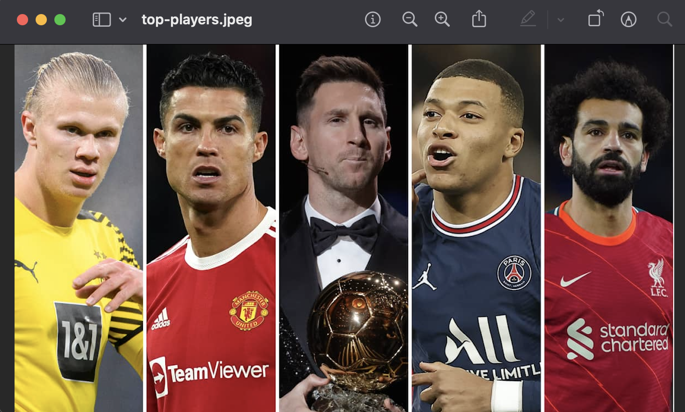
Real picture

Slide 10
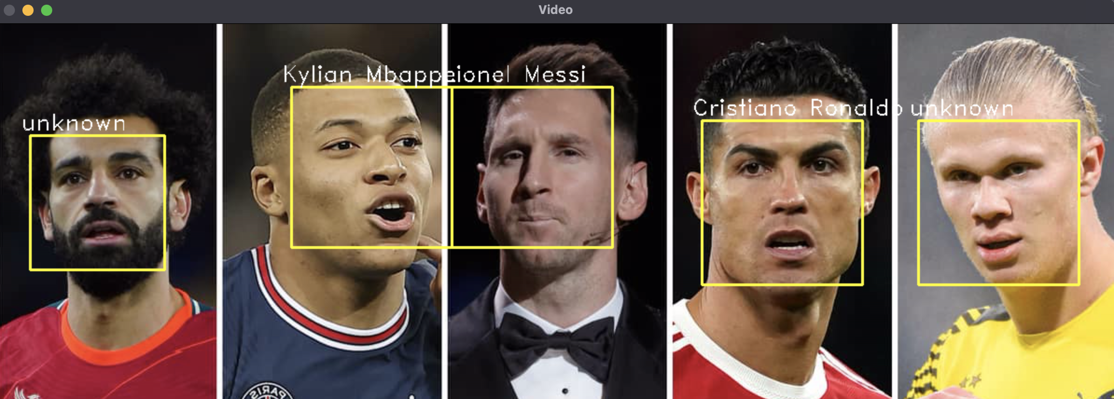
After using face recognition app

